Slide 1
Structure and Function of the Federal Government
Unit 3 – US Government

Slide 2
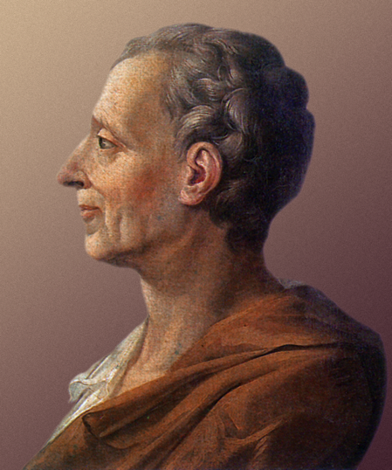
Separation of Powers
Division of government power into multiple branches with distinct and separate areas of responsibilities.
First evidenced in Aristotle’s Politics as he spoke of “mixed govt” in Greek city-states
Montesquieu’s “Tripartite System”
Spirit of the Laws, 1748
Legislative branch – enact, amend, repeal law
Executive branch – administration of state
Judicial branch – interpret & apply law
Designed to prevent any one person or group from concentrating too much power

Slide 3
Checks & Balances
A system of overlapping powers among the 3 branches allowing them to check (restrain) actions of the other branches
While head-on clashes between branches have been rare, the existence of these checks often influence behavior
On occasions of divided government, Congress & White House have clashed
Vetos, overrides, impeachments, rejection of presidential appointments…
What if 1 party controls Congress & POTUS?
Have such checks served to limit the scope of gov’t & prevent abuse of power?
Executive
Judicial
Legislative
Consider the terms of Representatives, Senators, Presidents, and Supreme Court Justices and America’s two-party system; how do these varying terms increase the likelihood that each party will have the ability to restrain members of the rival party within our Constitution?

Slide 4
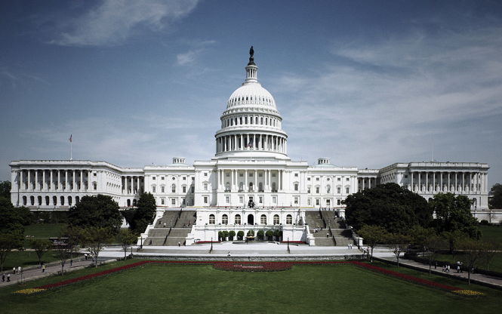
Article I – Legislative Branch
Legislative power vested in Congress
House of Representatives
Elected to 2 yr terms by members of a district, initially larger than 30K people
Total no. of Reps set at 435 in 1929
Shorter terms, local districts, directly elected = closer to the general will
Senate
Elected to 6yr terms, initially by state legislature, now directly elected(1913)
1/3rd of Senate is up for re-election every two years
Designed to be more deliberate, stable
The Senate and the House are both located within the U.S. Capitol building, sometimes known as “The Hill”. What are the requirements to be a Representative? A Senator?
Who represents you in Congress?

Slide 5
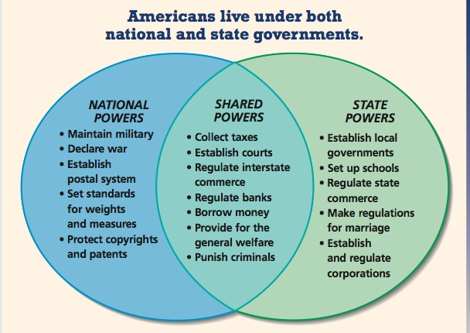
Federalism & Powers of Congress
Founding Fathers’ fear of tyrannical govt led to the creation of a federal system:
Federalism: sharing constitutional powers between a central govt and state govts
Founders limited powers of Congress to only those specifically expressed in Constitution
They also created implied powers through the “necessary and proper” clause
Constitution calls for concurrent or shared powers between state & central govt
Any legislative powers not specifically mentioned (or implied) are reserved for the states.

Slide 6
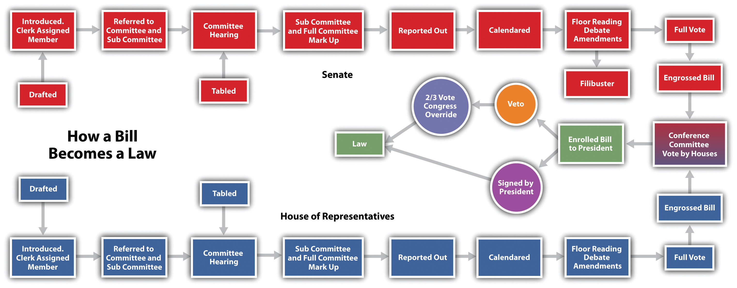
The Legislative Process
The actual legislative process is much messier, much more personal. [>]

Slide 7
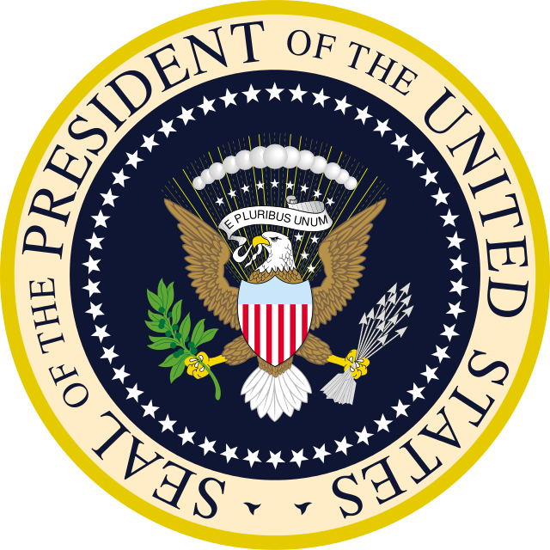
Article II – Executive Branch
Under our Constitution, the President serves as head of state & head of govt
Role: to oversee the application of the Federal govt on a day-to-day basis
4-yr term; granted powers to head the military, make treaties & appointments, propose legislation, & address Congress
Electoral College created to ensure that President would not be political outsider
Qualifications: at least 35, natural-born citizen, at least 14 years of residency
Presidential influence has grown in time
Executive privilege, executive orders, mass media have all increased POTUS’ power

Slide 8
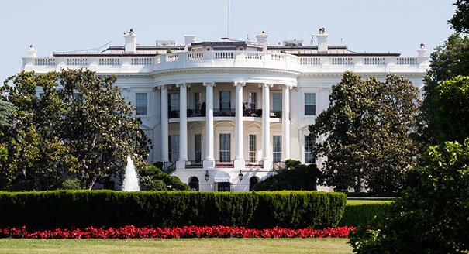
Powers of the President
The President has a great many roles these days…
Commander in Chief – civilian head of military
Chief of State – formal top official of US govt
Chief Diplomat – head of US foreign policy
Chief Executive – top admin. of federal bureaucracy
Chief Legislator – can propose and rally support for legislation, more influence than any Senator
Moral Leader – expected to set moral tone of nation
Party Leader – as their party’s most-visible member, POTUS expected to support party agendas
To fulfill these roles, POTUS lives a hectic life [>]
Every president since John Adams has resided in the White House while in office. The West Wing of the White House serves as the administrative office of the President, while the East Wing serves as a reception area. What are the minimum qualifications to become President?

Slide 9
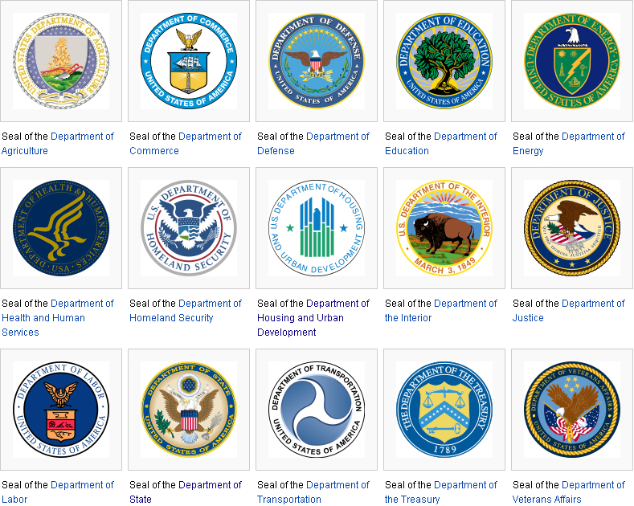
The Federal Bureaucracy
Executive Branch divided into 3 groups:
Executive Office of the President: complex organization of several separate agencies staffed by the President’s closest advisors
Budget, Nat’l Security, Economy, Environment…
Executive Departments: 15 specialized agencies, each headed by a secretary >>>
Each secretary is appointed by the President
15 secretaries comprise the President’s Cabinet
Independent Agencies: set up outside of executive branch to avoid partisan politics
The Fed, SEC, FCC, Nat’l Labor Board, CIA

Slide 10
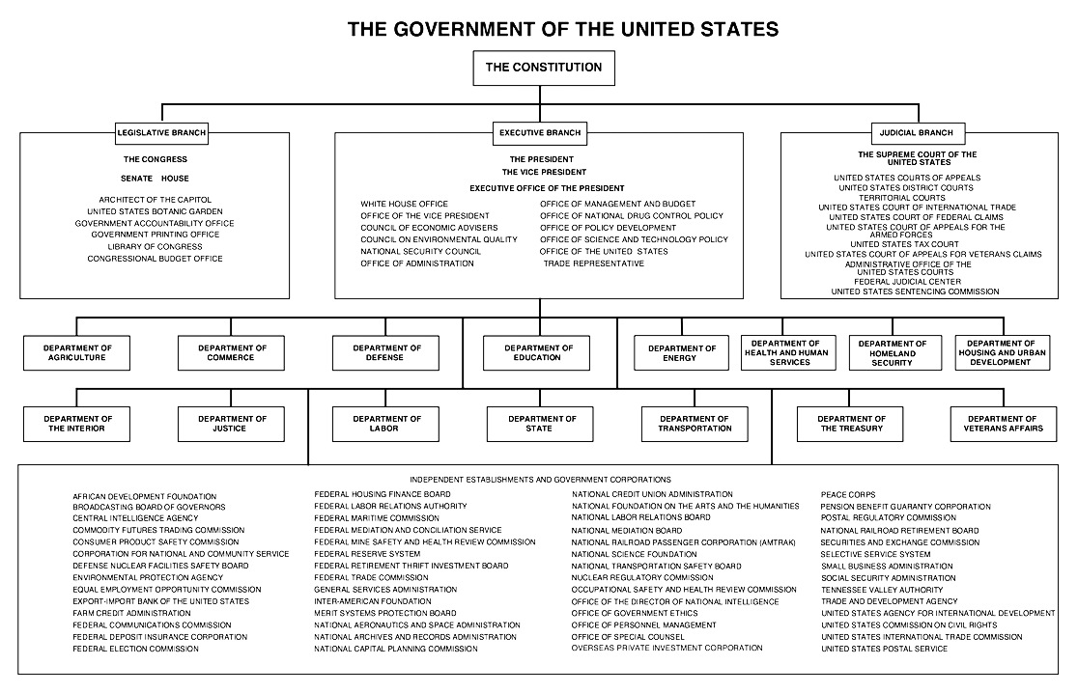

Slide 11
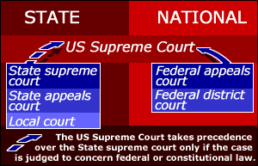
Article III – Judicial Branch
Judicial Power (to interpret & apply law) is vested in the Supreme Court and the inferior federal courts
Supreme Court – created by Constitution as court of last resort regarding federal law
Article III Courts – created by Congress to exercise broad judicial powers of USA
94 District Courts, 12 US Court of Appeals…
Article I Courts – created by Congress to hear cases arising from expressed powers
There are 2 separate court systems in the US: federal courts and state courts

Slide 12
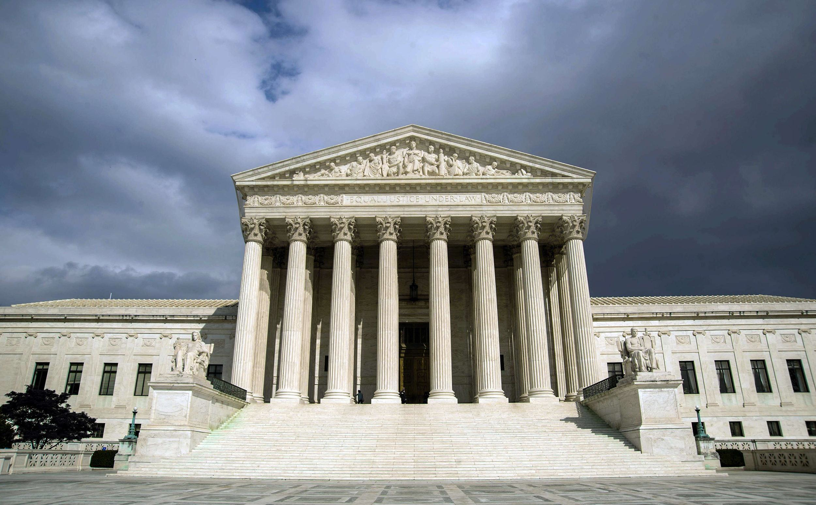
Supreme Court & Judicial Review
The Make-up of the Supreme Court
Justices appointed by POTUS to life term
Chief Justice plus 8 associate justices
Most cases heard by the SCOTUS are appeals from lower federal courts (appellate jurisdiction), rare cases may be heard for the first time (original)
Judicial Review: Empowering the Court
In Marbury v. Madison (1803) John Marshall claimed SCOTUS power to declare acts unconstitutional
Powerful check against other Branches
Some of the nation’s most dramatic legal moments have played out inside (and outside) of the United States Supreme Court Building. Supreme Court decisions provide a immediate and often definitive interpretation of federal law and the Constitution.

Slide 13
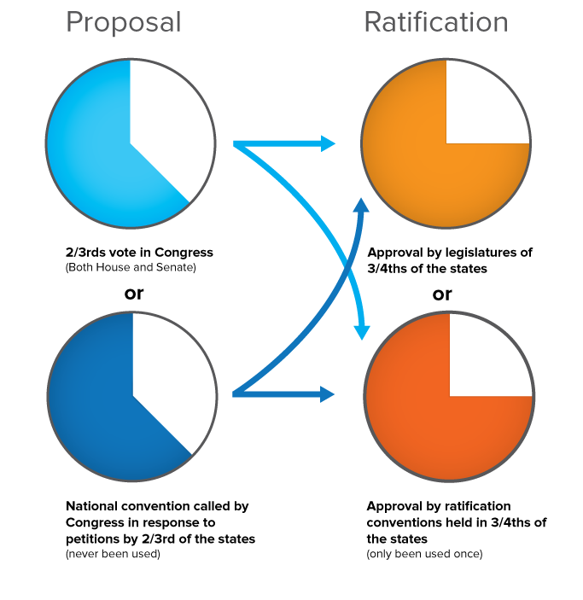
The Evolving Constitution
Language & meaning of the Constitution can change in a number of ways:
Formal Amendment Process (see chart)
27 amendments have been ratified
Congress creates Constitutional change
Laws can be passed to elaborate on the Constitution’s more-vague provisions
Expand the role of Congressional power
Constitution grows thru Executive action
Exec. orders & agreements, military force
Constitutional evolves w/ SCOTUS decisions
Majority opinions often add detail to the law

